Slide 1
Studies of Machine Learing approach based Sentiment Ananlysis in Social Media: public Mood based on their posts
Guided by : Prof. (Dr.) Abhoy Chand Mondal
Presented by: Soumi Samanta & Moupriya Manna
Department of Computer Science
The University of Burdwan

Slide 2
INDEX
Sentiment Analysis
Needs of sentiment analysis
Abstract
Introduction
Analysis of Data
How social media sentiment measured
Literature review
Limitations
Future
References

Slide 3
WHAT IS SENTIMENT ANALYSIS?
Social Sentiment refers to the emotion behind a social mention.
It means monitoring social media posts and discussions, then figuring out how participants are reacting.
It involves applying natural language processing(NLP) to social mentions and determining whether the user is responding in a positive, negative or neutral manner.

Slide 4
WHAT IS ITS NEED?
Improve customer service
Prevent social media crises
Measure the results of a social media campaign
Monitor your competitors
Improve your product according to your customers needs

Slide 5
Abstract
Nowadays, social media is such an important platform where we can know the situation of the world through thousands of posts. Sentiment analysis is a valuable tool to measure public opinion. It successfully devoted itself to health issues, brand marketing, crime prediction, financial market prediction, customer analytics, and emergency management. In which situation, public posts on those topics are vital for research on the basis of sentiment analysis. Many researchers publish sentiment analysis papers on social media because a large number of people use it and they are posting lots of topics in their daily lives, like text, photos, video, and audio. This data can be converted into vital information with the help of sentiment analysis. The public shares their current condition and situation on social media. For what reason does a person post that content on social media? Is it because that person wants suggestions on how to handle the situation or how to survive the condition, wants to know the solution to the problem, or generally shares happiness or sadness? We read about the accuracy and limits of several literature review publications, employed their models and datasets, and conducted surveys of them.

Slide 6
Introduction
Today, social media plays a big part in people's daily lives. The number of people who are not connected to social media is very small. They are linked to some platforms like Facebook, WhatsApp, Twitter, YouTube, and Instagram. People benefit from using social media. Not only is social media a medium of communication between people, but it is also an earning path for mankind. On social media, many people build up their businesses by communicating with others and want to get feedback to improve their service. As a result, the number of social media users is high, and I guess it will increase in the future. People express their emotions through the sharing of various texts, videos, and audio photos. For the development of business organizations, advanced technologies like machine learning and AI are used for data processing. This paper explains the applications of sentiment analysis using an experiment with published literature. Sentiment analysis is a way in which we classify a post as having a good, bad, or normal sentiment. There are two types of sentiment analysis: the machine learning approach and the lexicon-based approach. Machine learning is used to find sentiment from data, and a lexicon-based approach is used to regard good or bad words in the language. Most of the previous research on sentiment analysis was held under product or movie reviews, but now the challenge is to understand the public's mental situation at that moment when they are posting something and how the user reacts to seeing this post.

Slide 7
Analysis of data to understand
"How public posts on social media are subjected to sentiment analysis"

Slide 8
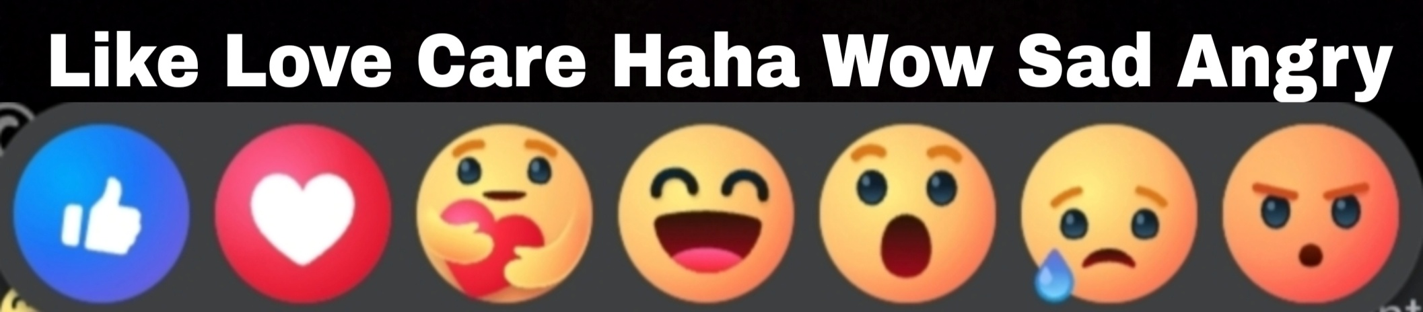
HOW SOCIAL MEDIA SENTIMENT IS MEASURED?

Slide 9

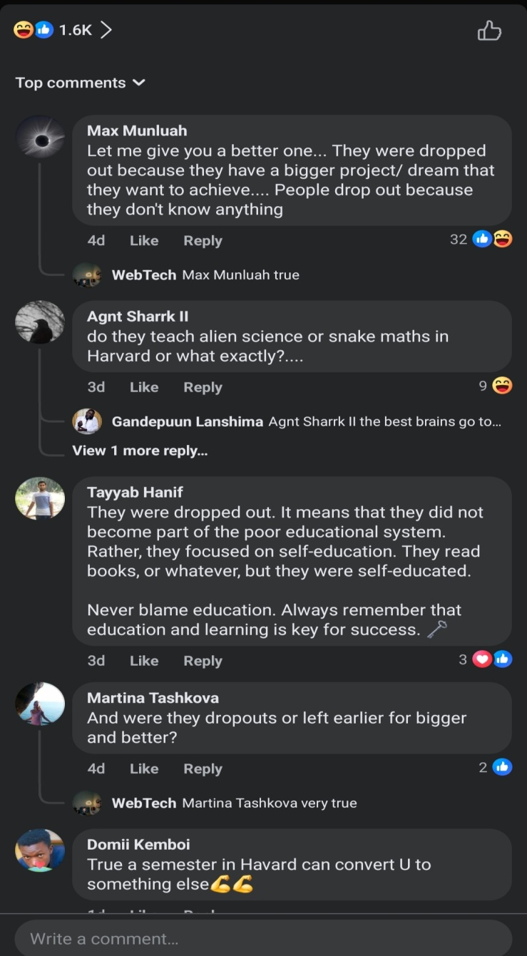
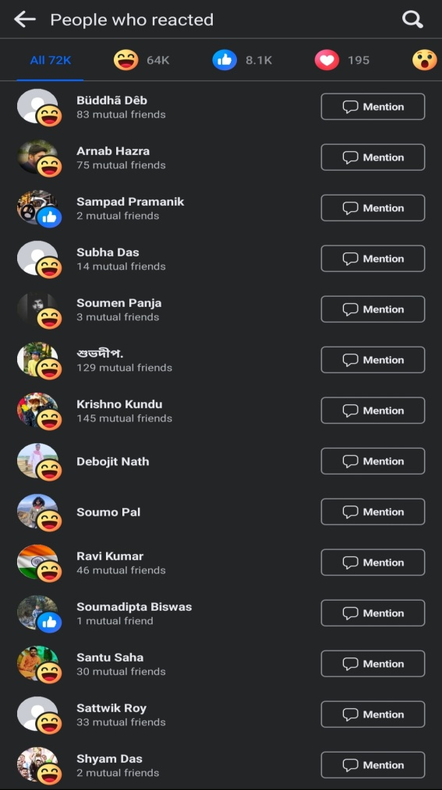
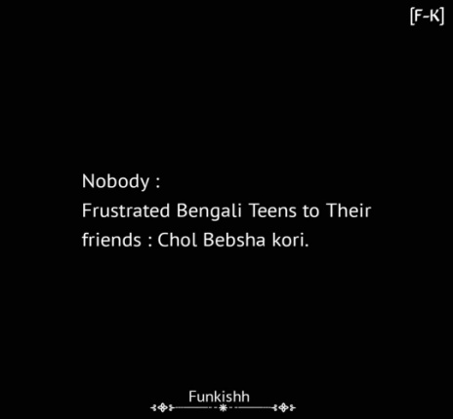


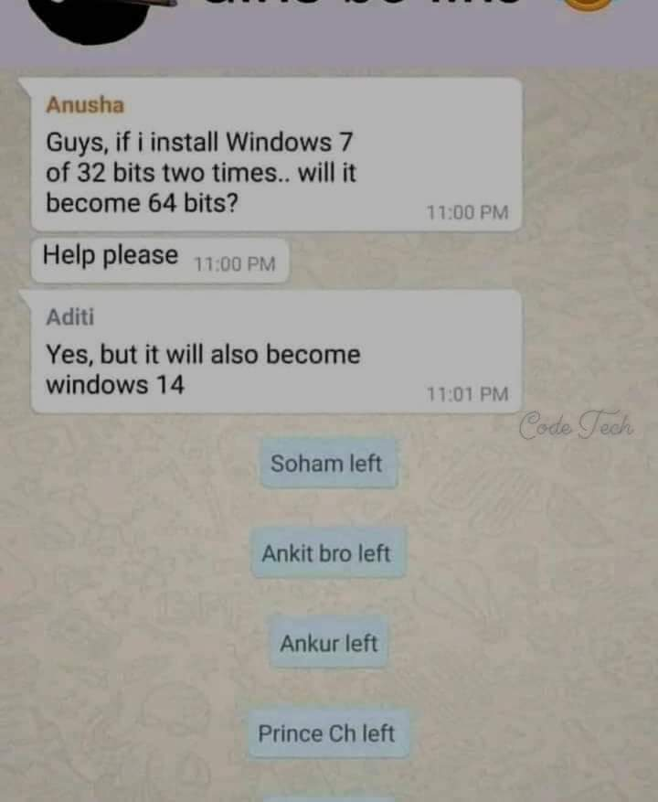


Slide 10
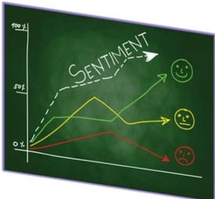

Slide 11
Literature Review

Slide 12
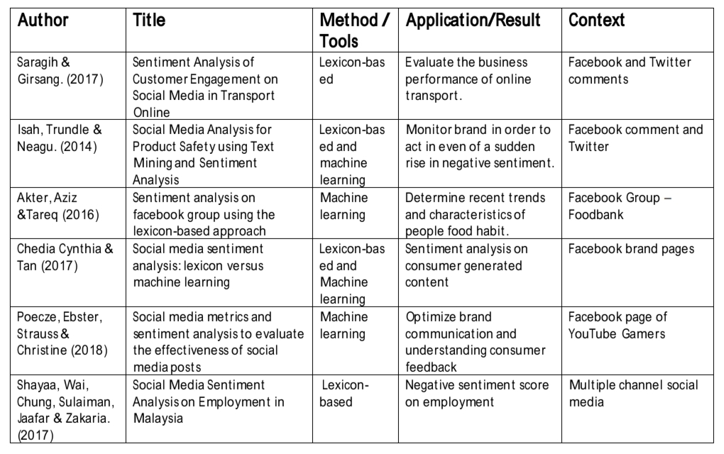

Slide 13
Limitations
Sentiment analysis in social media has limitations stemming from the complexity of human language. These include ambiguity, sarcasm, cultural nuances, and evolving language trends, making it challenging for algorithms to accurately interpret context and sentiment. Additionally, sentiment analysis may struggle with domain-specific jargon and the inability to understand non-textual elements such as emojis or tone of voice. These limitations can lead to inaccurate assessments of sentiment, potentially affecting the reliability of insights derived from social media data.

Slide 14
Future
The future of sentiment analysis in social media lies in advancing artificial intelligence and natural language processing technologies to better understand nuanced human emotions, context, and sarcasm. This includes deeper integration of machine learning algorithms to handle multilingual data, identify evolving trends, and provide more accurate sentiment insights for businesses, marketers, and researchers. Additionally, privacy concerns and ethical considerations will play a crucial role in shaping the development and adoption of sentiment analysis tools in social media platforms.

Slide 15
References
www.facebook.com
www.instagram.com
www.twitter.com
Chekima, Khalifa, and Rayner Alfred. (2018) Sentiment Analysis of Malay Social Media Text. pp. 205- 219.
Ebrahimi, M.m Yazdavar, A., and A. Sheth. (2017) “On the Challenges of Sentiment Analysis for Dynamic Events.” Intelligent Systems, IEEE 32 (5).
Das, Bijoyan, and Sarit Chakraborty. (2018) An Improved Text Sentiment Classification Model Using TF-IDF and Next Word Negation.
Khan, Muhammad Taimoor, Mehr Durrani, Armughan Ali, Irum Inayat, Shehzad Khalid, and Kamran Habib Khan. (2016) “Sentiment Analysis and The Complex Natural Language.” Complex Adaptive Systems Modeling 4 (1): 2.
Akter, Sanjida, and Muhammad Tareq Aziz. (2016) “Sentiment Analysis on Facebook Group Using Lexicon Based Approach”, in the 2016 3rd International Conference on Electrical Engineering and Information Communication Technology (ICEEICT).
Hassan, Anees Ul, Jamil Hussain, Musarrat Hussain, Muhammad Sadiq, and Sungyoung Lee. (2017) “Sentiment Analysis of Social Networking Sites (SNS) Data Using Machine Learning Approach for the Measurement of Depression”, in International Conference on Information and Communication Technology Convergence (ICTC), Jeju, South Korea: IEEE.
Rahman, S. A. El, F. A. AlOtaibi, and W. A. AlShehri. (2019, 3-4 April 2019). “Sentiment Analysis of Twitter Data”, in the 2019 International Conference on Computer and Information Sciences (ICCIS).
Ali, Kashif, Hai Dong, Athman Bouguettaya, Abdelkarim Erradi, and Rachid Hadjidj. (2017) “Sentiment Analysis as a Service: A Social Media Based Sentiment Analysis Framework”, in IEEE International Conference on Web Services (ICWS), Honolulu, HI, USA: IEEE.

Slide 16


